Slide 1
Online Voting System
Online Voting System
Ashutosh Dixit, Raunak Pandey,Prince Arya,Harsh Nishad
GLA University
CEA
29/11/2023

Slide 2
Introduction
The project aims to modernize voting systems by creating an online voting platform using React Tailwind and backend.
It addresses issues with traditional methods by enhancing accessibility and security.
The audience can expect a presentation detailing how these technologies combine to create an intuitive, secure, and visually appealing voting interface.

Slide 3
Objectives
Develop an online voting platform using React and Tailwind CSS.
Improve accessibility for voters by creating a user-friendly interface.
Ensure the security and integrity of the voting process.
Showcase the advantages of technology-driven voting systems over traditional methods.

Slide 4
Problem Statement
Accessibility issues: Lack of inclusivity for diverse voter needs.
Security vulnerabilities: Risks of fraud or tampering in paper-based systems.
Inefficiency: Manual processes leading to resource drain and time consumption.

Slide 5
Literature Review
Overview of existing projects in modernizing voting systems.
Emphasis on the gap in creating a holistic, user-centric voting platform.

Slide 6
Methodology
Technology Selection: Choosing React for its dynamic interface capabilities and Tailwind CSS for streamlined design and responsiveness.
Frontend Development: Utilizing React components to create a user-friendly voting interface with Tailwind CSS for visual styling and layout.
Backend Integration: Implementing secure data handling and processing, ensuring the integrity of votes cast.
Security Measures: Incorporating encryption protocols and access controls to prevent tampering or unauthorized access.
Languages: JavaScript (React framework), HTML, CSS
Tools: React.js, Tailwind CSS, Node.js (for backend integration), various encryption libraries for security protocols

Slide 7
System Architecture
Visual diagrams showing how components interact.
Concise descriptions of each component's role and interaction.
Emphasis on secure data flow and efficient communication between frontend and backend components.

Slide 8

Implementation
LOGIN PAGE

Slide 9
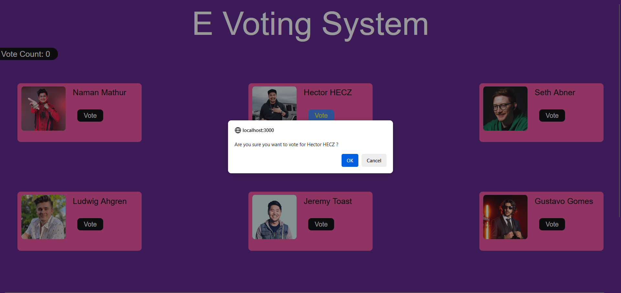

Voting Page
Rating Page

Slide 10
Features
Key Features Overview:
Highlighting the modern interface, enhanced accessibility, and secure voting mechanism.
Unique Functionalities:
Emphasizing real-time result display, user-friendly interaction, and scalability.
Technology Integration:
Showcasing the significance of React and Tailwind CSS in creating a unique and effective voting system.
User Experience Benefits:
Focusing on how these features improve the overall voting experience for users.

Slide 11
Future Work
Future Improvement Opportunities:
Discussing potential enhancements in security, authentication, analytics, mobile accessibility, and language support.
Additional Functionalities:
Highlighting the significance of advanced analytics, multi-language support, and real-time feedback for an improved voting experience.
Innovation Pathways:
Exploring innovative technologies like biometrics or blockchain for identity verification and data security.
User-Centric Approach:
Emphasizing the focus on accessibility improvements and continuous user feedback for ongoing enhancements.

Slide 12
Conclusion
Project Goals:
Created a secure, user-friendly, and innovative voting platform.
Unique Aspect:
Unprecedented use of React and Tailwind CSS in voting systems.
Key Features:
Enhanced accessibility, real-time results, and robust security measures.
Challenges Overcome:
Addressed integration, security, and scalability hurdles effectively.
Future Scope:
Identified avenues for enhancing security, authentication, and analytics.

Slide 13
Acknowledgments
Professors and Mentors: For their guidance, expertise, and invaluable insights throughout the project's development.
Peers and Team Members: For their unwavering support, collaboration, and dedication, making this project a collective effort.
Supportive Individuals: Whose encouragement and feedback significantly shaped the project's direction and outcomes.
Institution/University: For providing resources, encouragement, and an environment conducive to innovation and learning.

Slide 14


